Slide 1
ShelfLink
ShelfLink is an innovative E-Library Management System that simplifies digital resource management. Its user-friendly interface ensures quick access to materials, making library operations more efficient for both administrators and users.

Slide 2
Software testing is a crucial part of ensuring the quality and reliability of any software application, particularly for systems like the E-Library Management Platform, where efficient access to resources and data security are essential. Our team has developed this platform to manage member registration, book inventory, and profile management, and we have implemented thorough testing strategies to identify and address any issues early in the development process. This approach helps ensure that the platform meets user requirements, performs efficiently, and handles sensitive data securely.
Introduction

Slide 3
Contents
01
Tech Stack of ShelfLink
02
Overview of ShelfLink
03
Testing Tools
04
Testing Process
05
Key Test Cases
06
Test Execution & Code Coverage
07
Challenges & Solutions
08
Recommendations
09
Conclusion

Slide 4



Tech Stack of ShelfLink

Slide 5

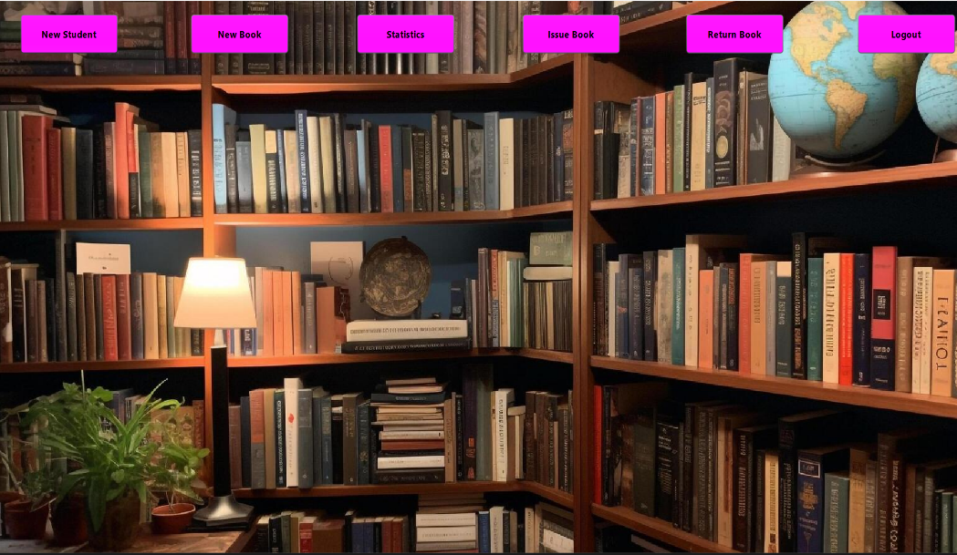
Overview of ShelfLink
Login Page
Home Page

Slide 6
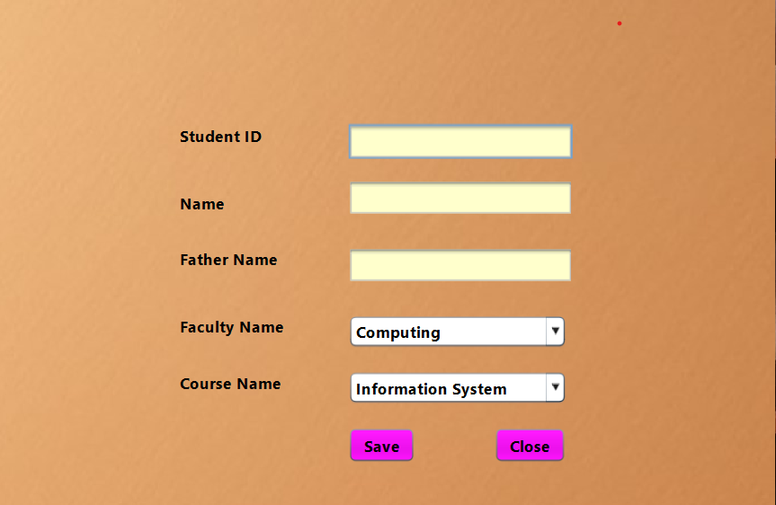
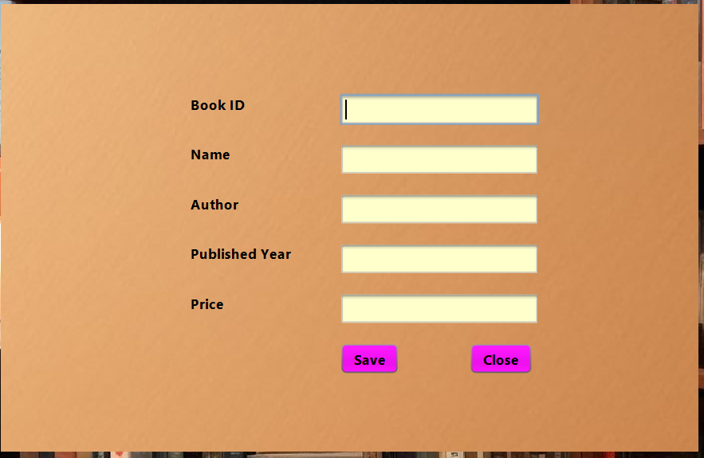
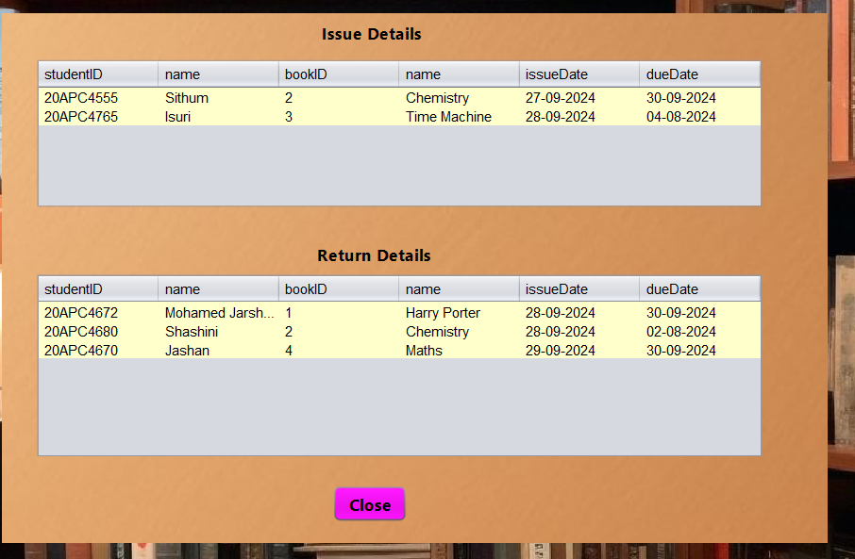
Overview of ShelfLink
New Student
New Book
Statistics

Slide 7
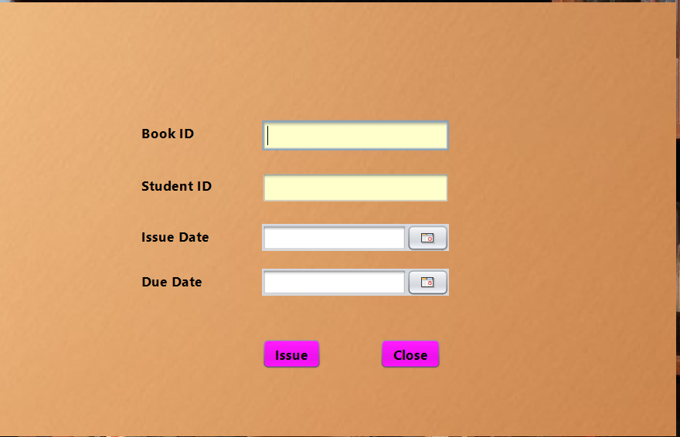
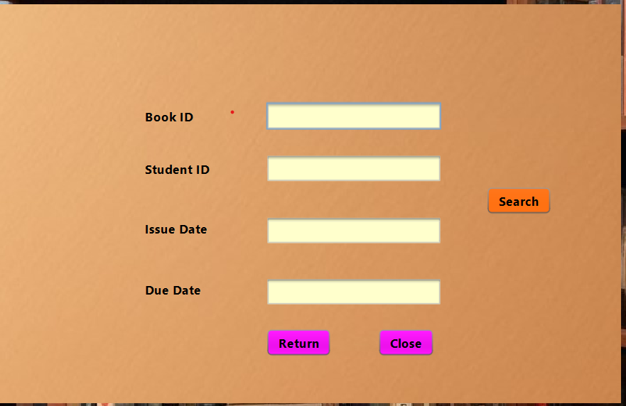
Overview of ShelfLink
Issued Book
Return Book

Slide 8


Testing Tools
JUnit
Utilized for unit testing, JUnit is a popular framework for testing individual components or methods in Java applications. It helps in validating the functionality of specific pieces of code in isolation.
Selenium
Selenium Used for integration and system testing, Selenium automates browser interactions to test the application as a whole. It checks interactions between different components and ensures the application functions correctly in a real-world environment.

Slide 9

Testing Process
Unit Testing: Verifies individual components (e.g., methods, functions) for correctness.
Integration Testing: Ensures different modules interact correctly (e.g., student and admin modules).
System Testing: Validates the complete system’s functionality in real-world conditions.
Acceptance Testing: Confirms that the system meets user requirements and is ready for deployment.

Slide 10

Unit Testing
Objective:
Ensure individual components (such as functions and methods) work as expected in isolation.
What to Test:
Login Validation: Test the correctness of input fields, password verification, and error handling for invalid credentials.
Registration Functionality: Check the validation of student/admin registration fields, error messages for invalid data, and successful user creation.

Slide 11
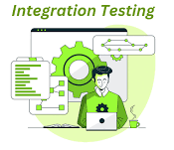
Integration Testing
Objective:
Ensure that different system modules (e.g., login, new student, new book, statistics, issued books, return books) work together seamlessly.
What to Test:
Test issuing and returning books, ensuring these actions are correctly reflected in the system’s database.
Check integration between profile management and borrowing history.

Slide 12

Acceptence Testing
Objective:
Validate the system against user requirements and ensure it’s ready for deployment.
What to Test:
User Experience: Ensure the system provides a seamless experience for both students and admins.
Real-World Scenarios: Test using real-world scenarios to check if the system behaves as expected under practical conditions.

Slide 13

System Testing
Objective:
Test the entire system as a whole to ensure it meets the specified requirements.
What to Test:
Verify the full student journey: registration, login, borrowing books, and returning books.
Test admin functionalities: managing books, generating reports, handling student profiles.
Ensure overall system stability under normal and peak load conditions.

Slide 14
Key Test Cases
User Login: Validate that a registered user can log in with correct credentials.
Add New Student - Ensures users can add new books with required fields like StudentID, Name, Father Name, Faculty Name and Course Name.
Add New Book - Ensures users can add new books with required fields like BookID, Name, Author, Published year and Price.
Issued Book - Verifies users can borrow books from the inventory with no residual data.
Return Book - Verifies users can return books from the inventory with no residual data.

Slide 15
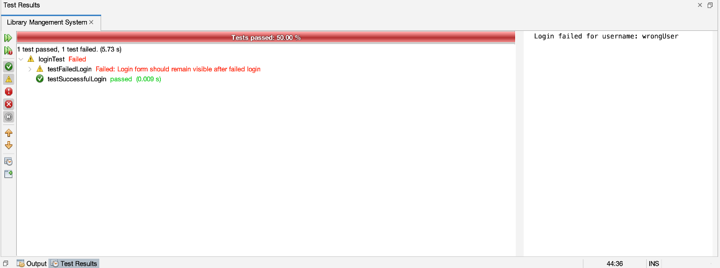
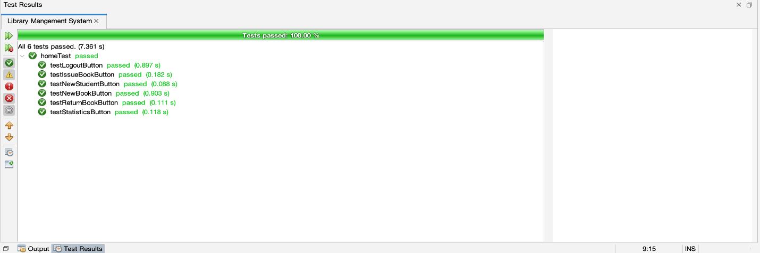
Test Execution & Code Coverage

Slide 16
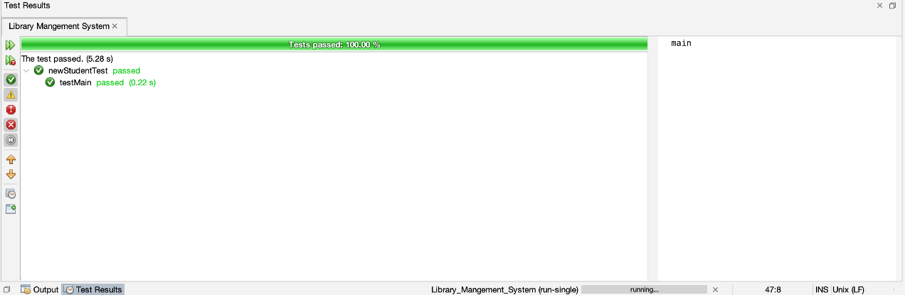
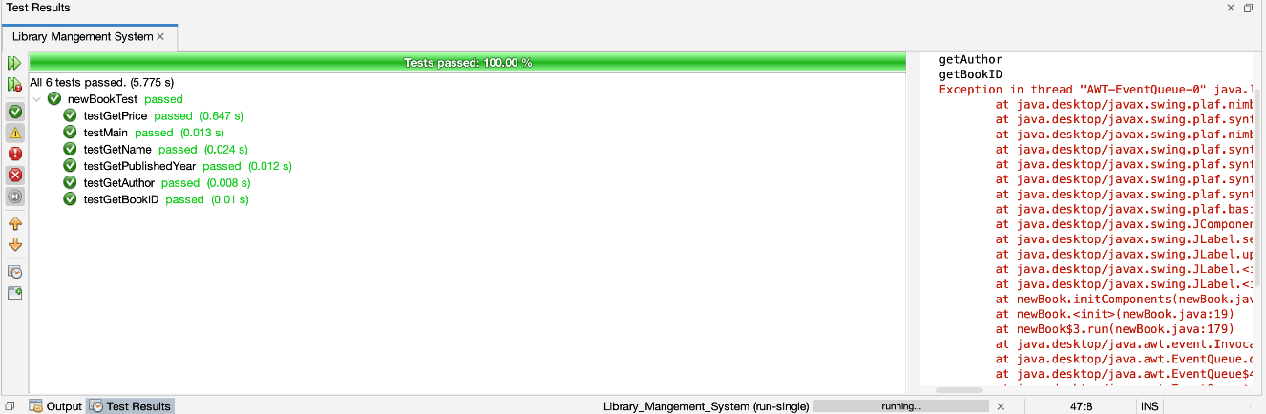
Test Execution & Code Coverage

Slide 17

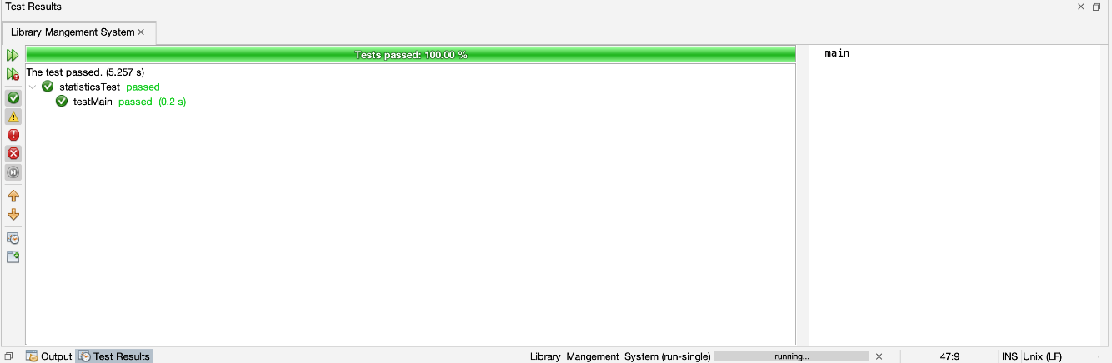
Test Execution & Code Coverage

Slide 18
Challenges
Test Data Management
In some cases, the test data would become corrupted, leading to false negatives in test results.
Performance Testing
The testing environment sometimes couldn't handle the load, resulting in unreliable performance metrics.
Dynamic Content and User Interface
The website frequently updated its content dynamically based on user behavior and preferences, making it difficult to create stable test cases, especially for UI testing.

Slide 19
Solutions
Test Data Management
We implemented a test data management strategy that included versioning of datasets and automated scripts to reset the data to a known good state before each test run.
Performance Testing
We utilized cloud-based load testing tools like Apache JMeter to simulate high user loads. Additionally, we upgraded the testing environment to better mimic production conditions.
Dynamic Content and User Interface
We employed automation tools with advanced capabilities for handling dynamic content, such as Selenium WebDriver with explicit waits and assertions tailored to handle asynchronous content loading.

Slide 20
Recommendations
Continuous integration and testing.
Regular updates to the testing framewok.
Increased focus on security testing.
More extensive load and performance testing.

Slide 21
Conclusion
In outline, our testing efforts effectively uncovered critical issues and areas for enhancement in the eCommerce platform. Unit testing validated the reliability of individual components, while performance testing provided insights into how the system handles real-world traffic. The challenges encountered were addressed with practical solutions, resulting in a more robust and efficient platform.

Slide 22
Group Members
Index Number | Name
20APC4656 | DSC Wijesinghe
20APC4676 | S Tharmika
20APC4672 | JM Jarshan
20APC4574 | KVSA Dias
20APC4561 | KLE Isurika

Slide 23
Thank you
Group 21

